Slide 1
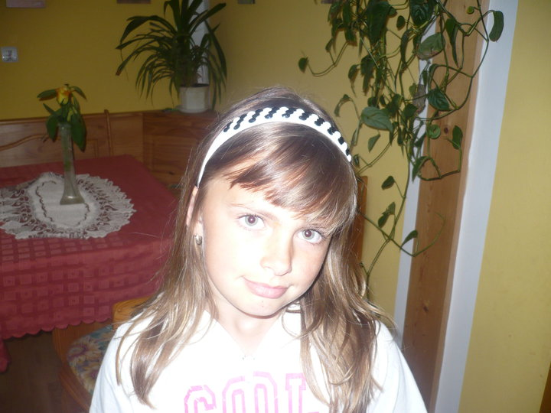
Kristýna Dokoupilová
I have one brother and one sister.
I like riding my bike.
I like Geography.

Slide 2
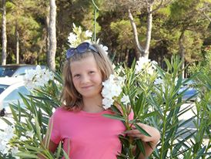
I have got one sister. I like strawberries. I like English.
Kateřina Klementová

Slide 3
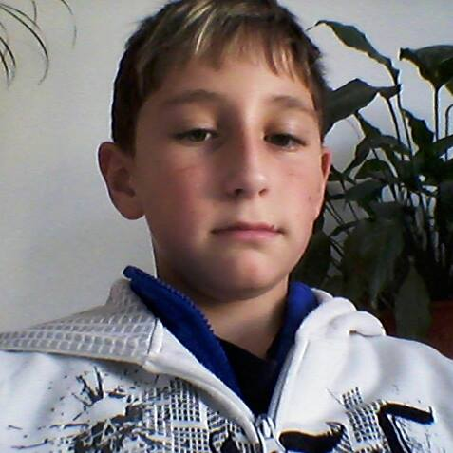
Lukáš Ošlejšek
I have got one sister.
I like ice hockey.
I like English language.

Slide 4
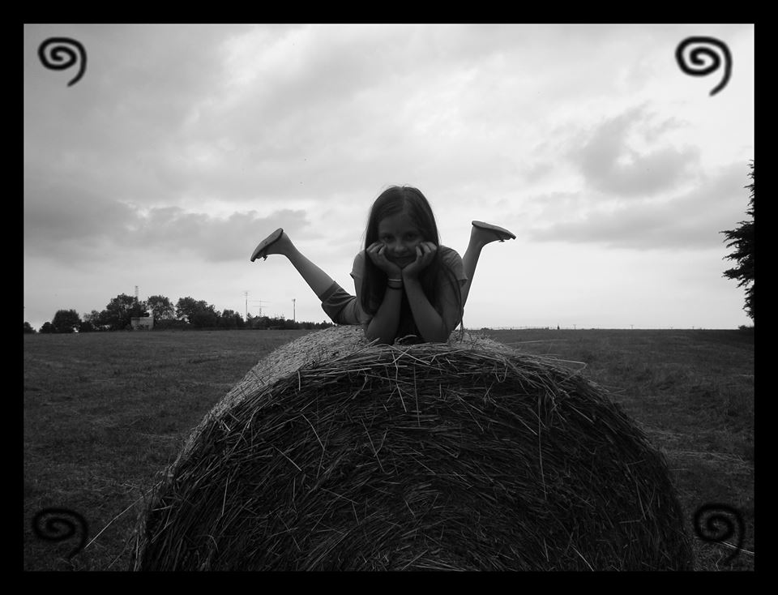
Klára Hanáčková
I have got one sister.
I love animals.
I don´t like Math.

Slide 5
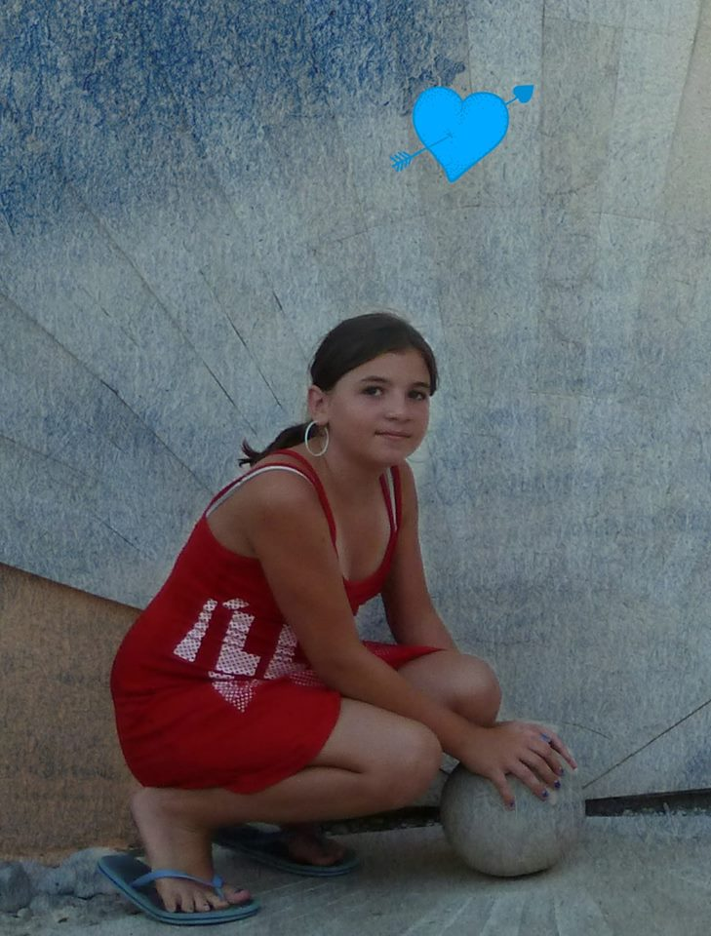
Lenka Luňáčková
I have got two sisters.
I like friends.
I like History.

Slide 6
Hynek Svoboda
I have got one brother and one sister.
I like football.

