Slide 1
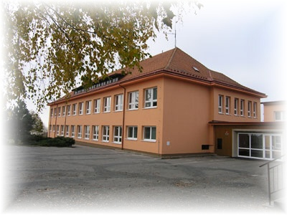
ZŠ a MŠ Benešov
There are 125 pupils in our school. The school is situated on the hill (721 m above the sea)
and it is surounded by beautiful nature.

Slide 2
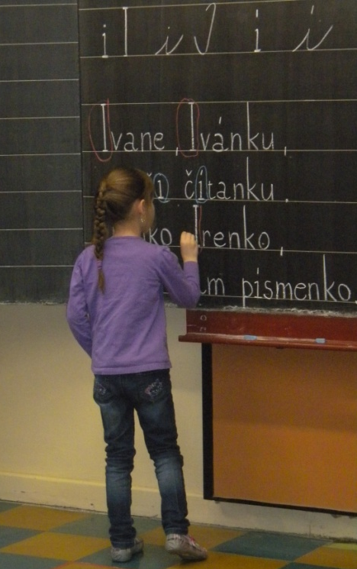
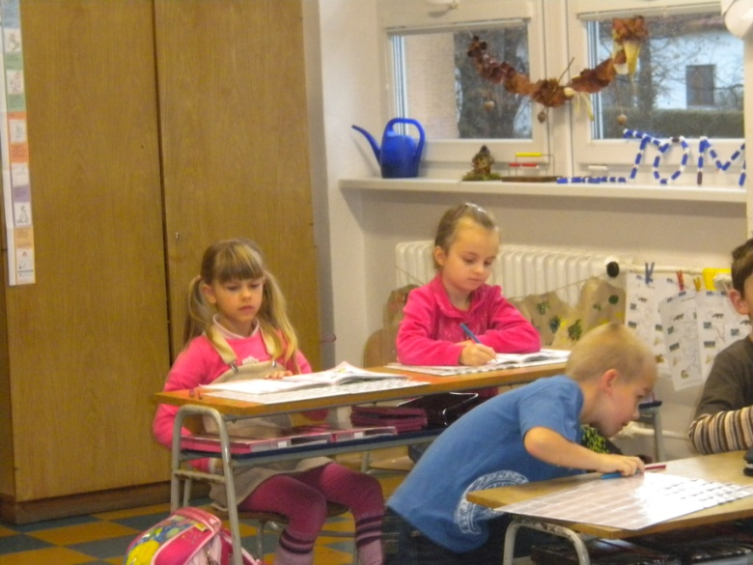
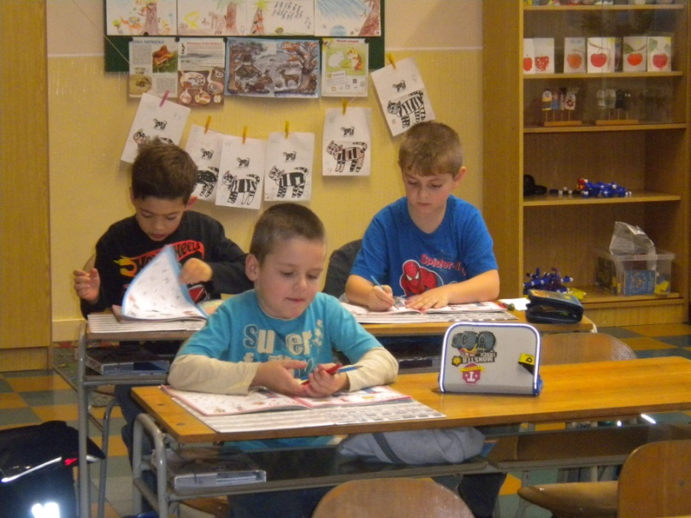
Here we are in the 1st class. Do you remember your start of the school ?
We wish these children
☺ GOOD LUCK ☺

Slide 3
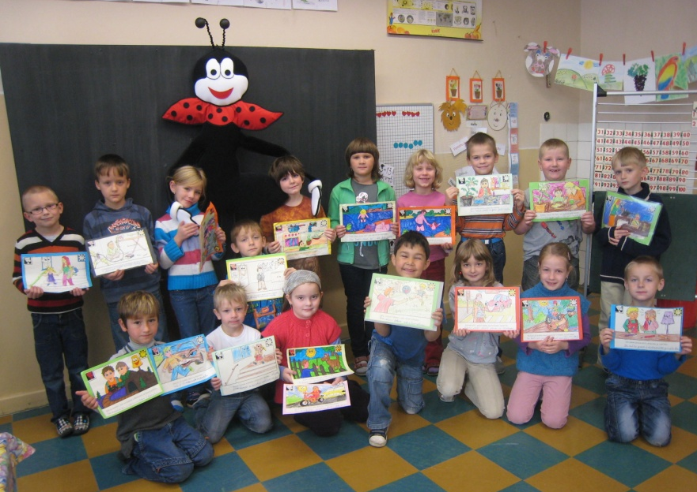
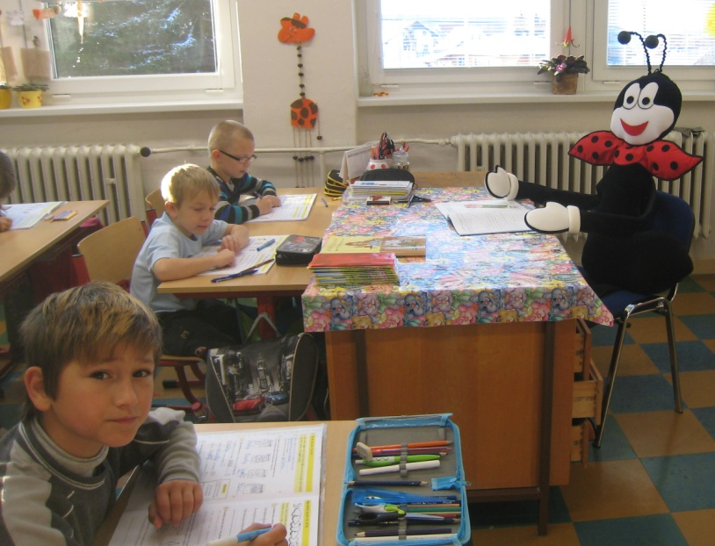
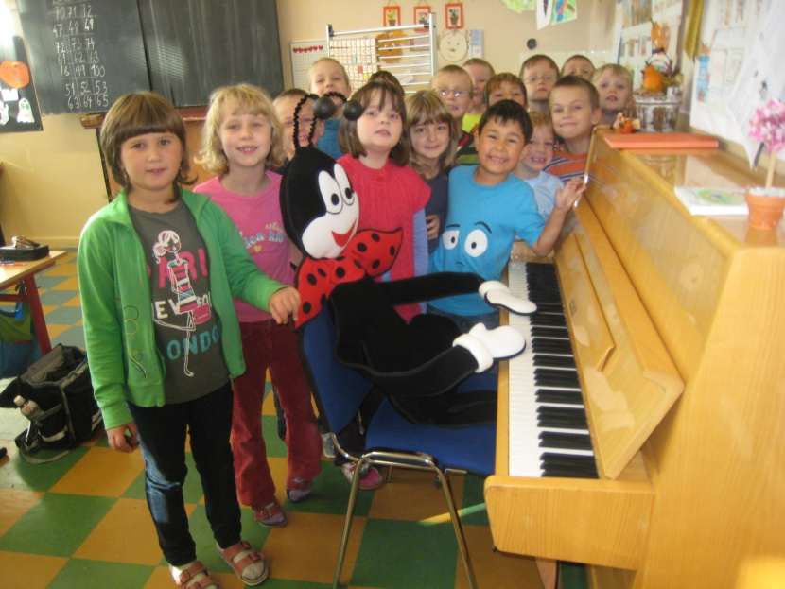
In the 2nd class pupils do the project with the Ferda the Ant.
He helps them with learning and tries to do lessons funny.

Slide 4
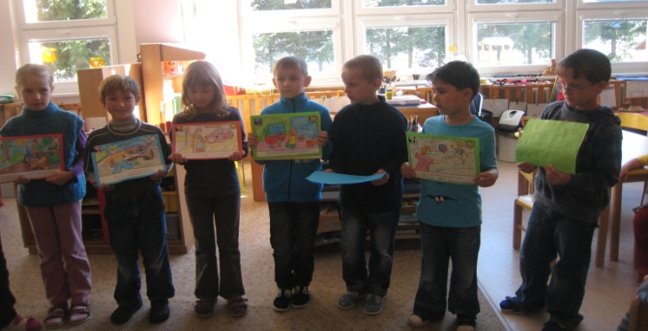
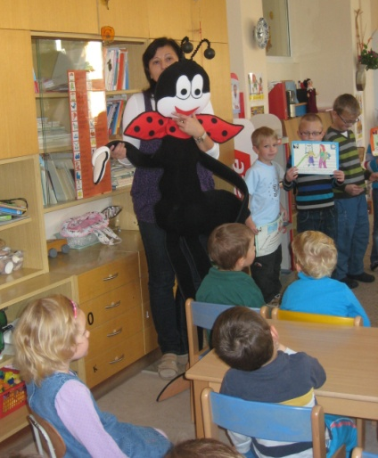
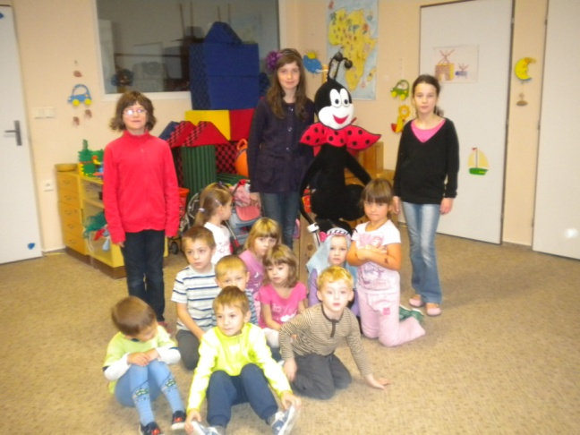
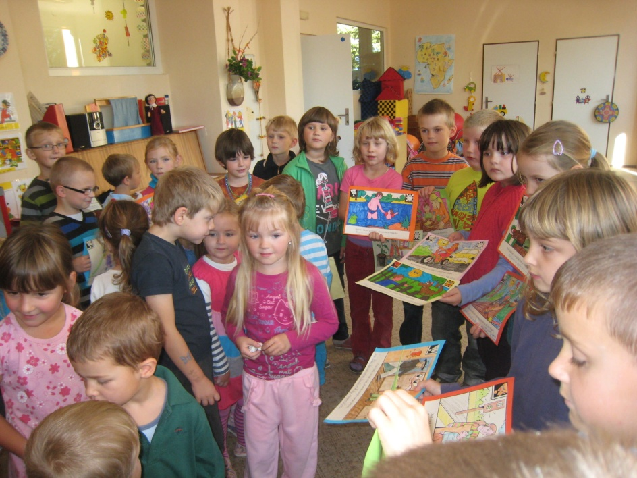
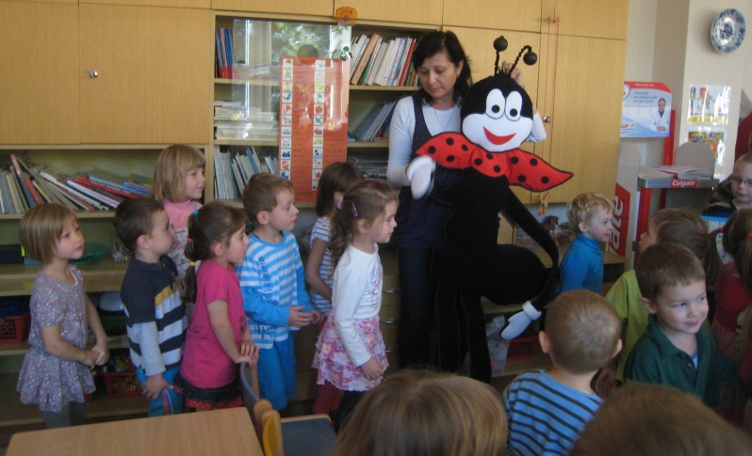
Our famous Ferda the Ant came to the nursery school as well. He told the children here how to behave safely in winter time. Every little child in our country knows the tale about Ferda the Ant who was ill.

Slide 5
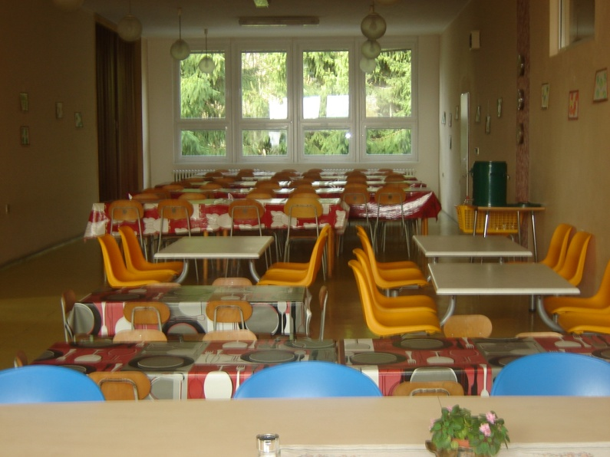
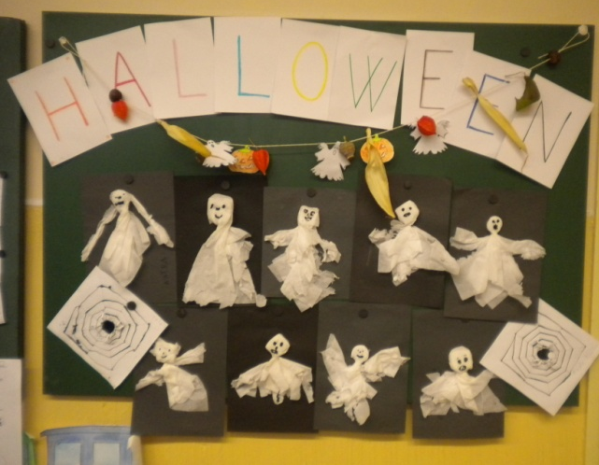
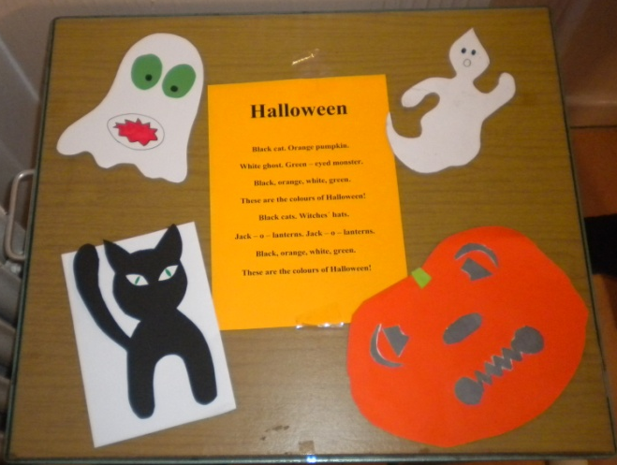
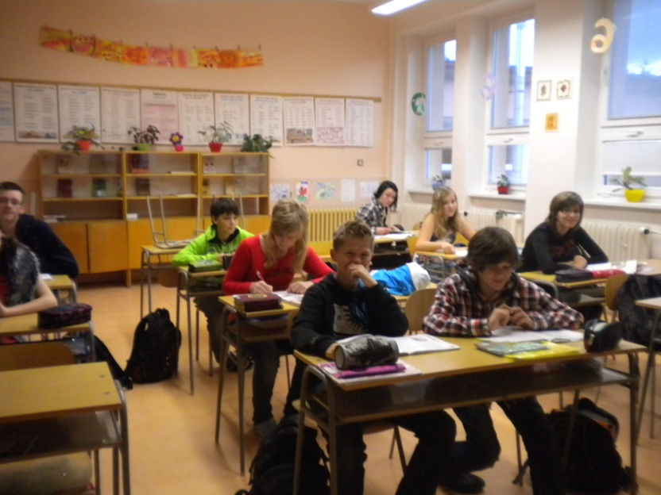
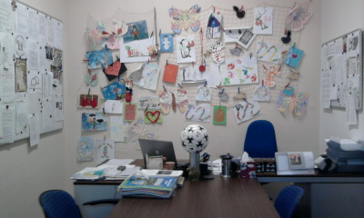
Our notice boards
School canteen
The 8th class
Headmaster´s room

Slide 6
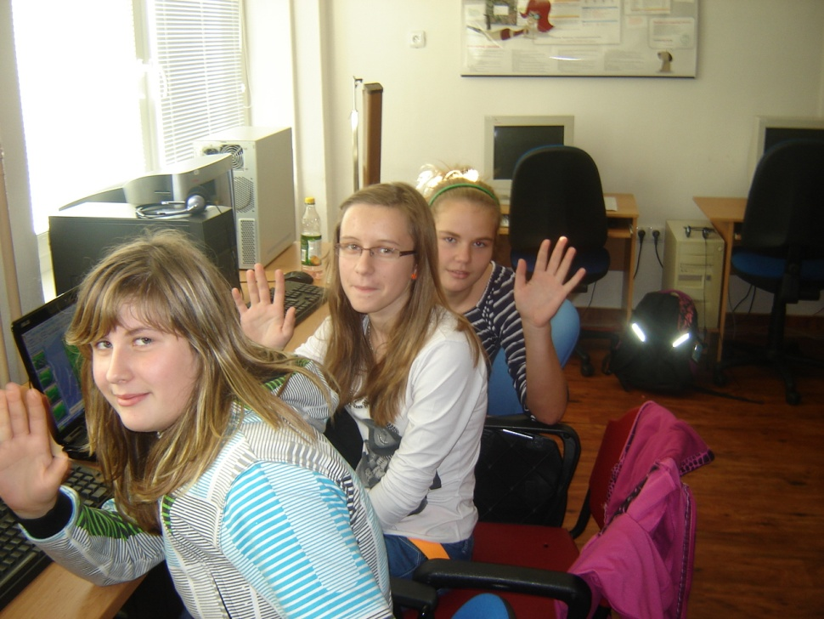
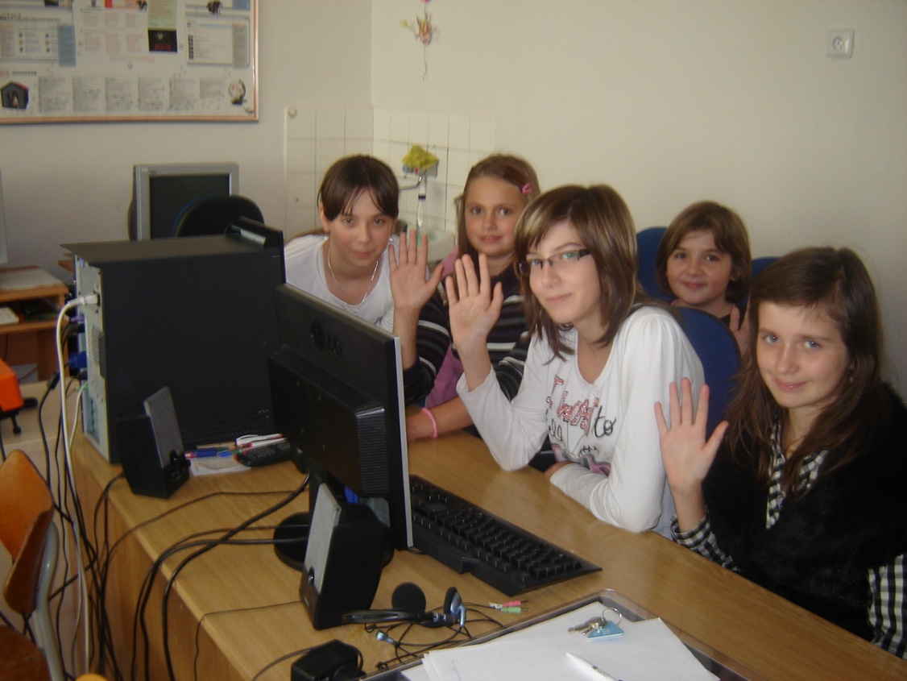
And these are girls who made this presentation for you.
Michaela Menšíková, Hana Přikrylová, Petra Rathouská, Anna Zemánková, Kristýna Dokoupilová, Petra Luňáčková, Lenka Luňáčková and Michaela Kováčová.

