Slide 1
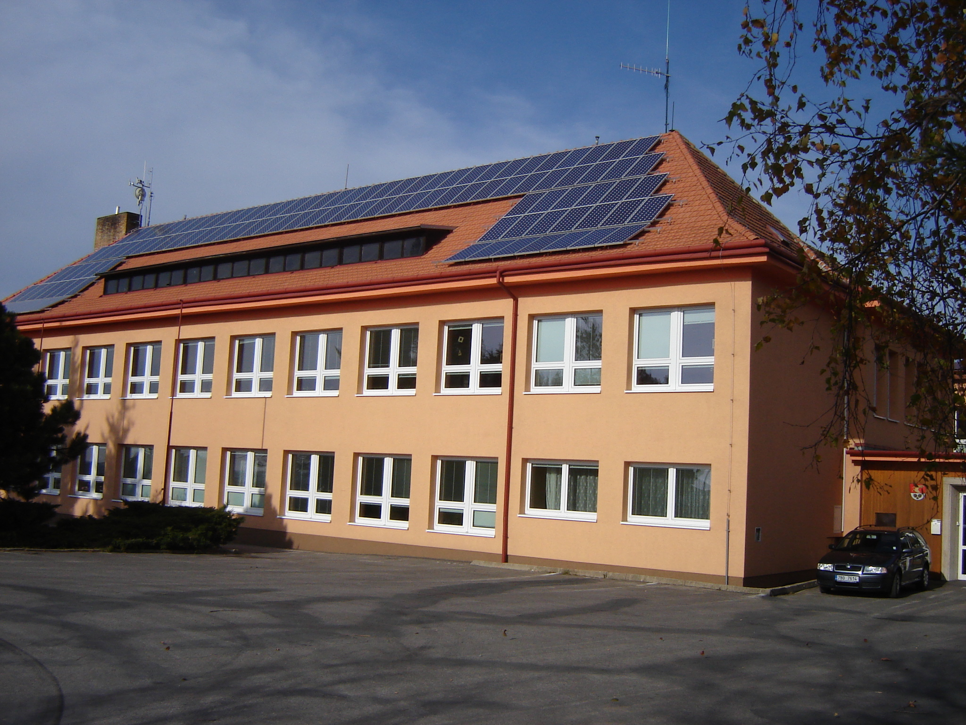

Our project activities

Slide 2

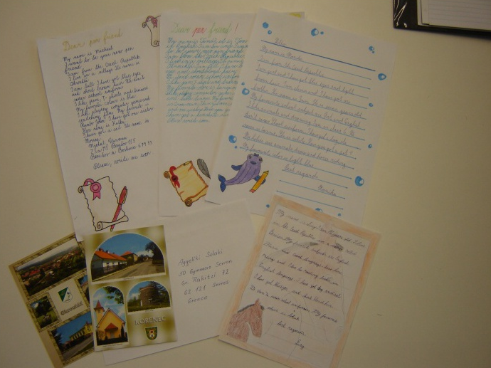
Our first project was OUR LIFE.
We went in for an exchange correspondence with children from other countries.

Slide 3
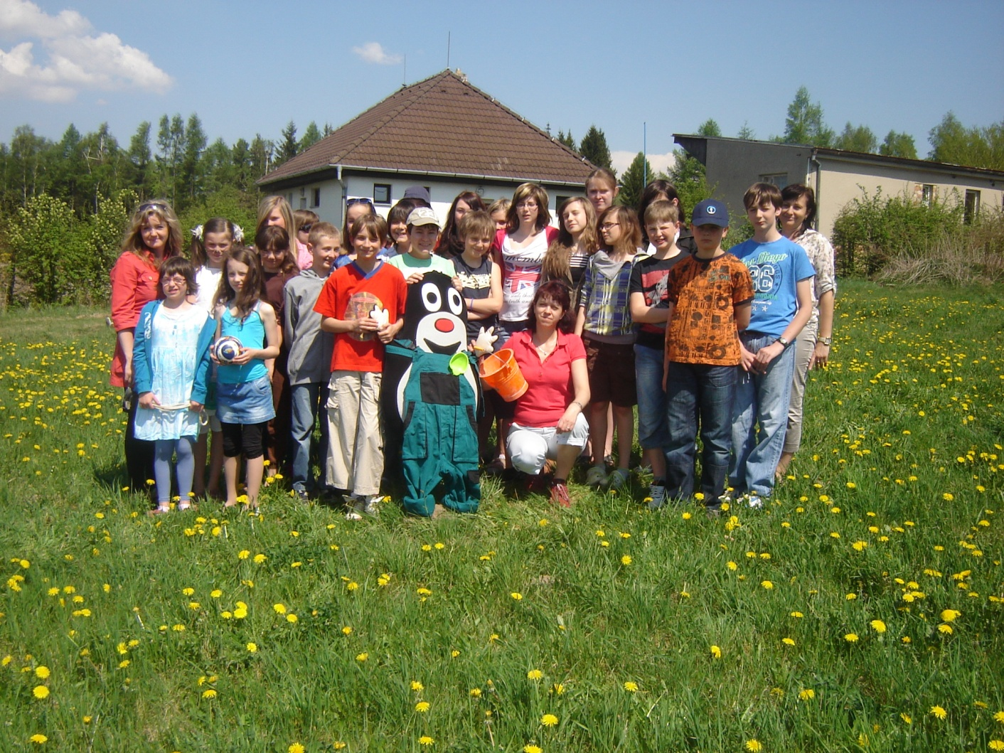
Then we joined the project STORY-BASED ENGLISH TEACHING.

Slide 4
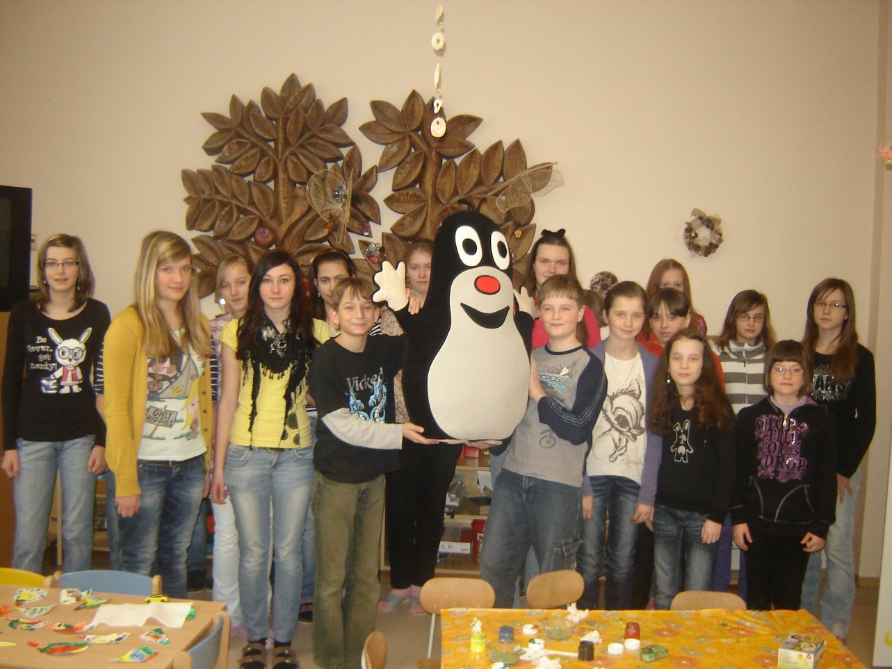
We gave our Little Mole to children in the local nursery school.

Slide 5
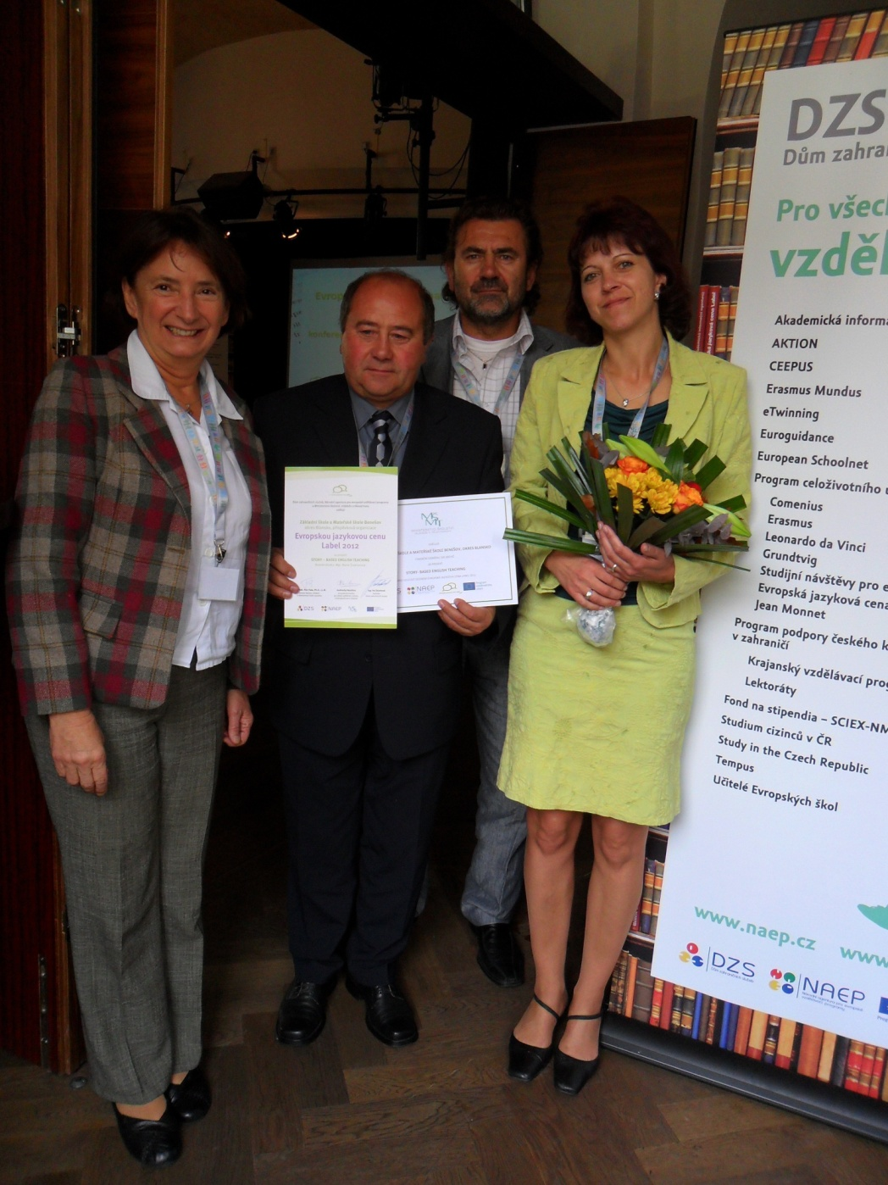
We won the price called Label for work
on language projects
in our republic.

Slide 6
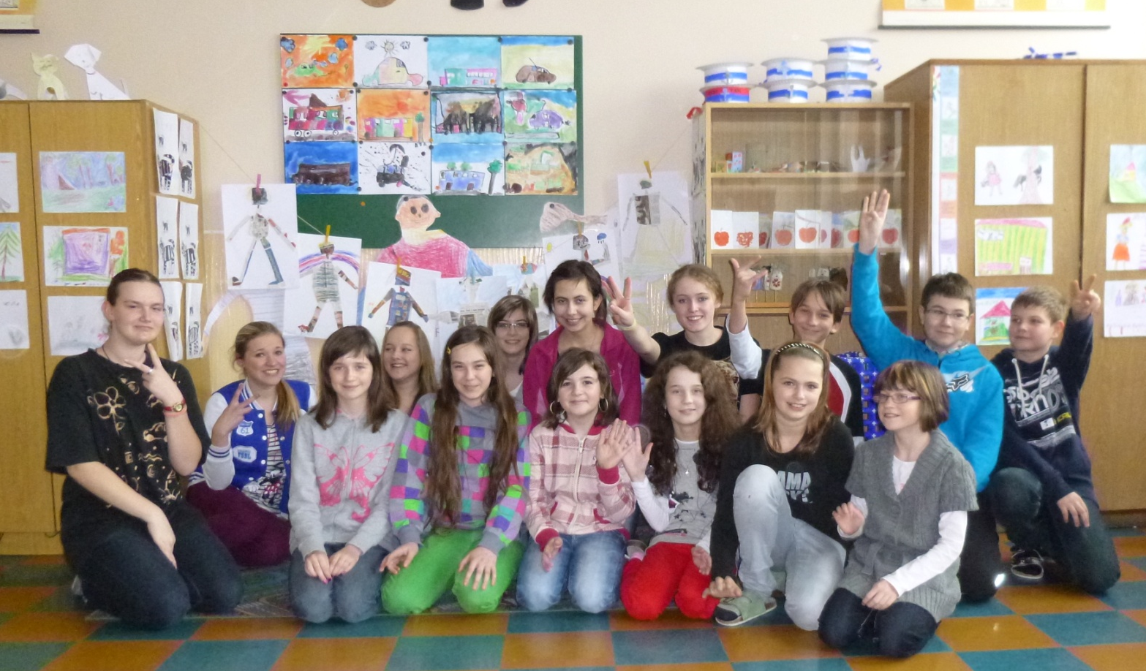
This year we are involved in project A VIRTUAL TRIP TO OUR COUNTRY.

Slide 7
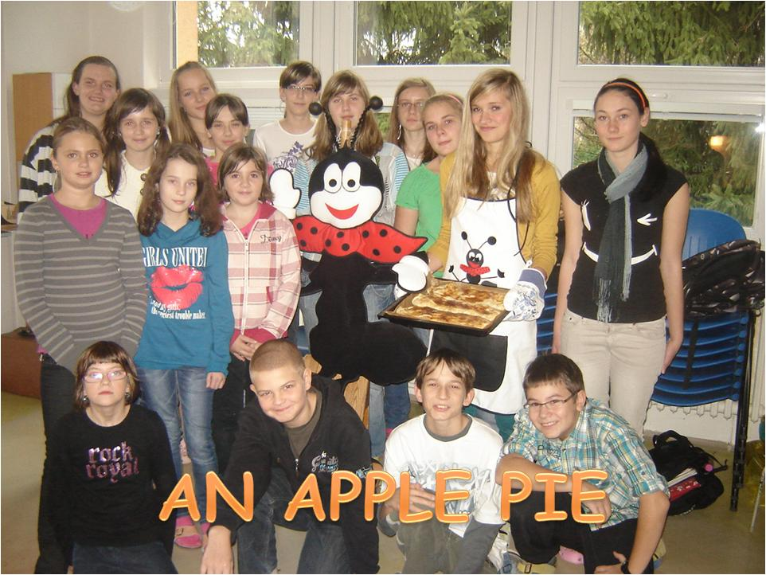
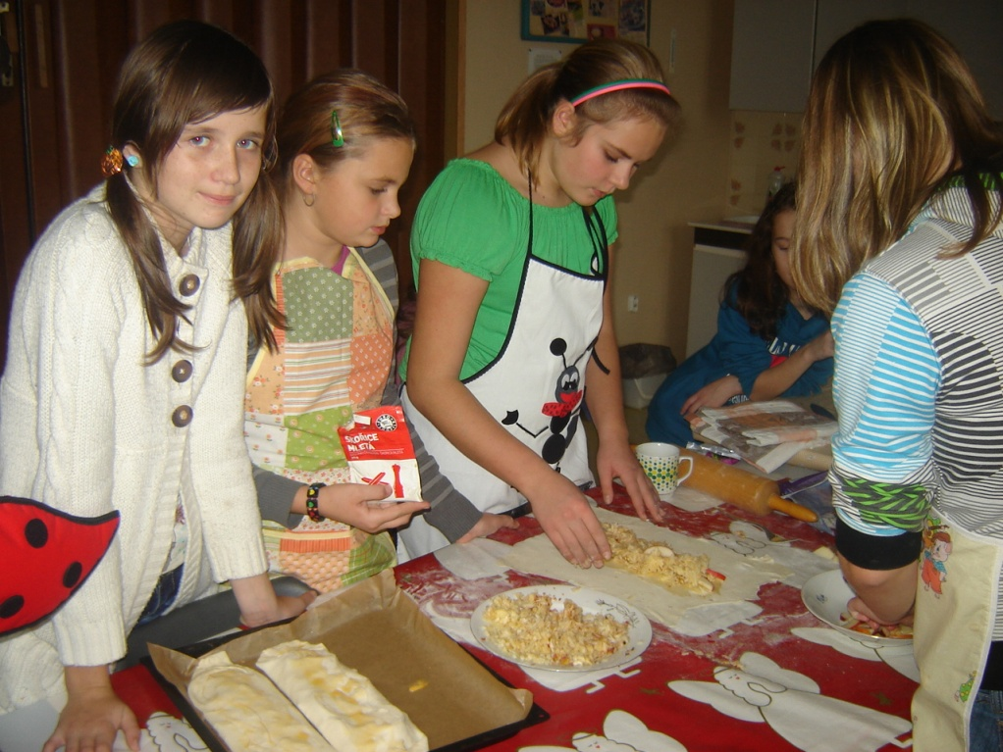
We baked an apple pie.

Slide 8
A Generous Lion
A stingy hunter sees a lion in the forest and he starts to watch it. The lion catches a big deer and it takes the dead deer to its own family to eat.
After its family has eaten the deer meat ,the lion starts some of the remained but it doesn’t finish the whole meat and gives it to the other lions. Hunter watches the sharing soul among the animals in astonishment. He comes back to his home feeling sad about his stingy character.
‘’We can learn something from everybody sometimes even from animals.”
We translated many texts.

Slide 9
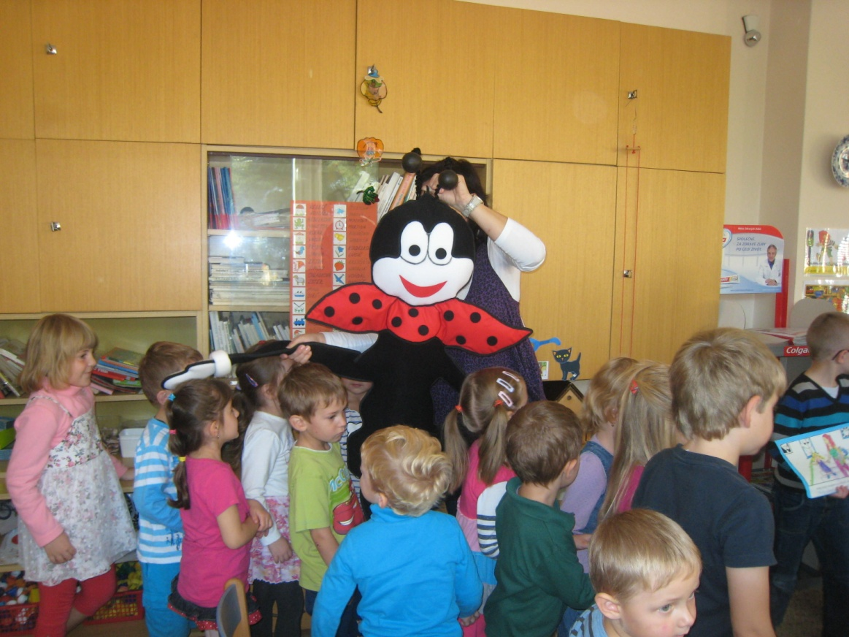
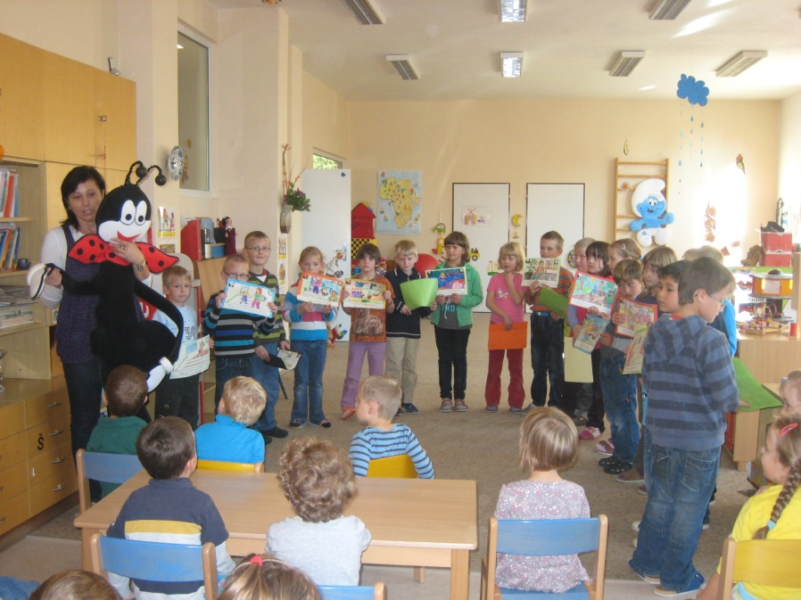
Children had a nice time with soft Ferda the Ant. He told them something about how to stay fit and healthy.

