Slide 1
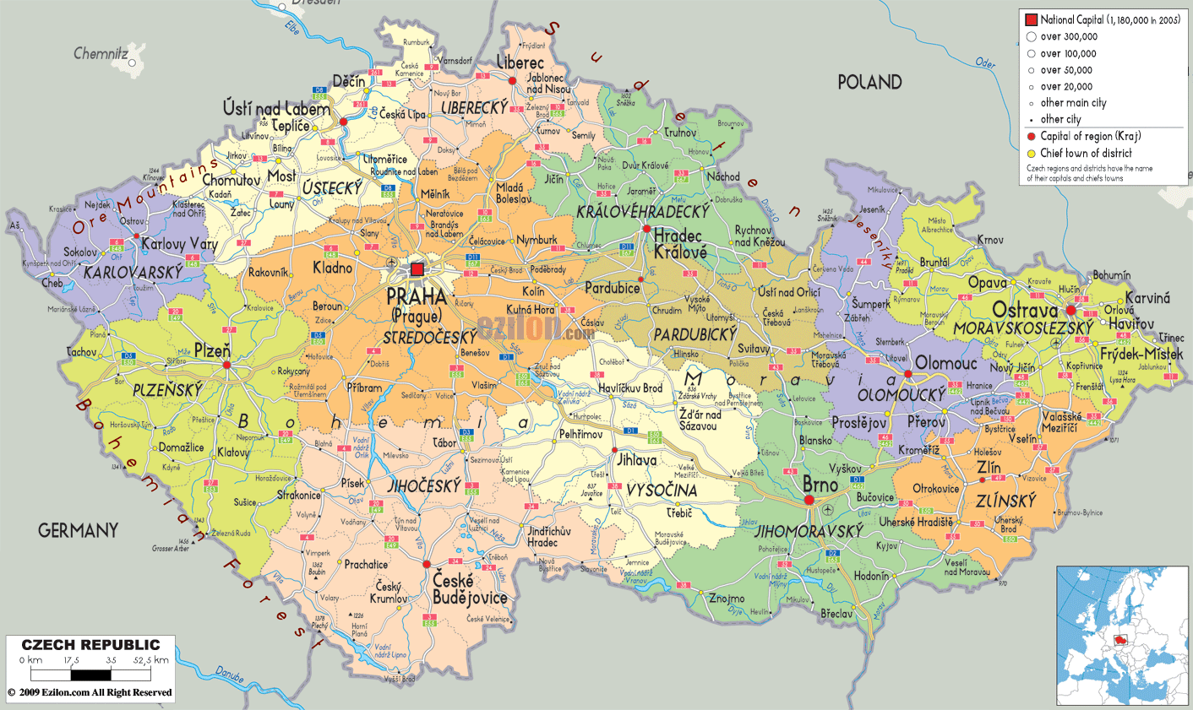
CZECH REPUBLIC
Martina Boninsegna
&
Maria Maddalena Venturini

Slide 2
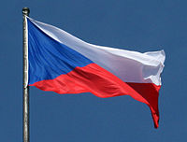
GEOGRAPHY
The Czech Republic is a Member State of the European Union from 2004 located in Central Europe.
It is bordered to the south-east by Slovakia, to the south by Austria, to the west with Germany and to the north with Poland.
The climate of the Czech Republic is continental.
This was part of NATO since 1999.

Slide 3
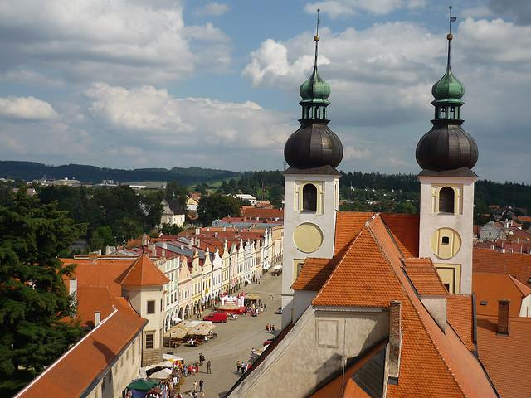
CULTURE
The capital of Czech Republic is Prague
The country now has just over 10 million people, with an average density of 132 inhab. / Km ². The population distribution is unequal.
The inhabitants of the Czech Republic is divided into two ethnic groups: the Bohemians and the Moravians.
Religion more practised is the Catholicism.
The most spoken language is Czech.

